Slide 1

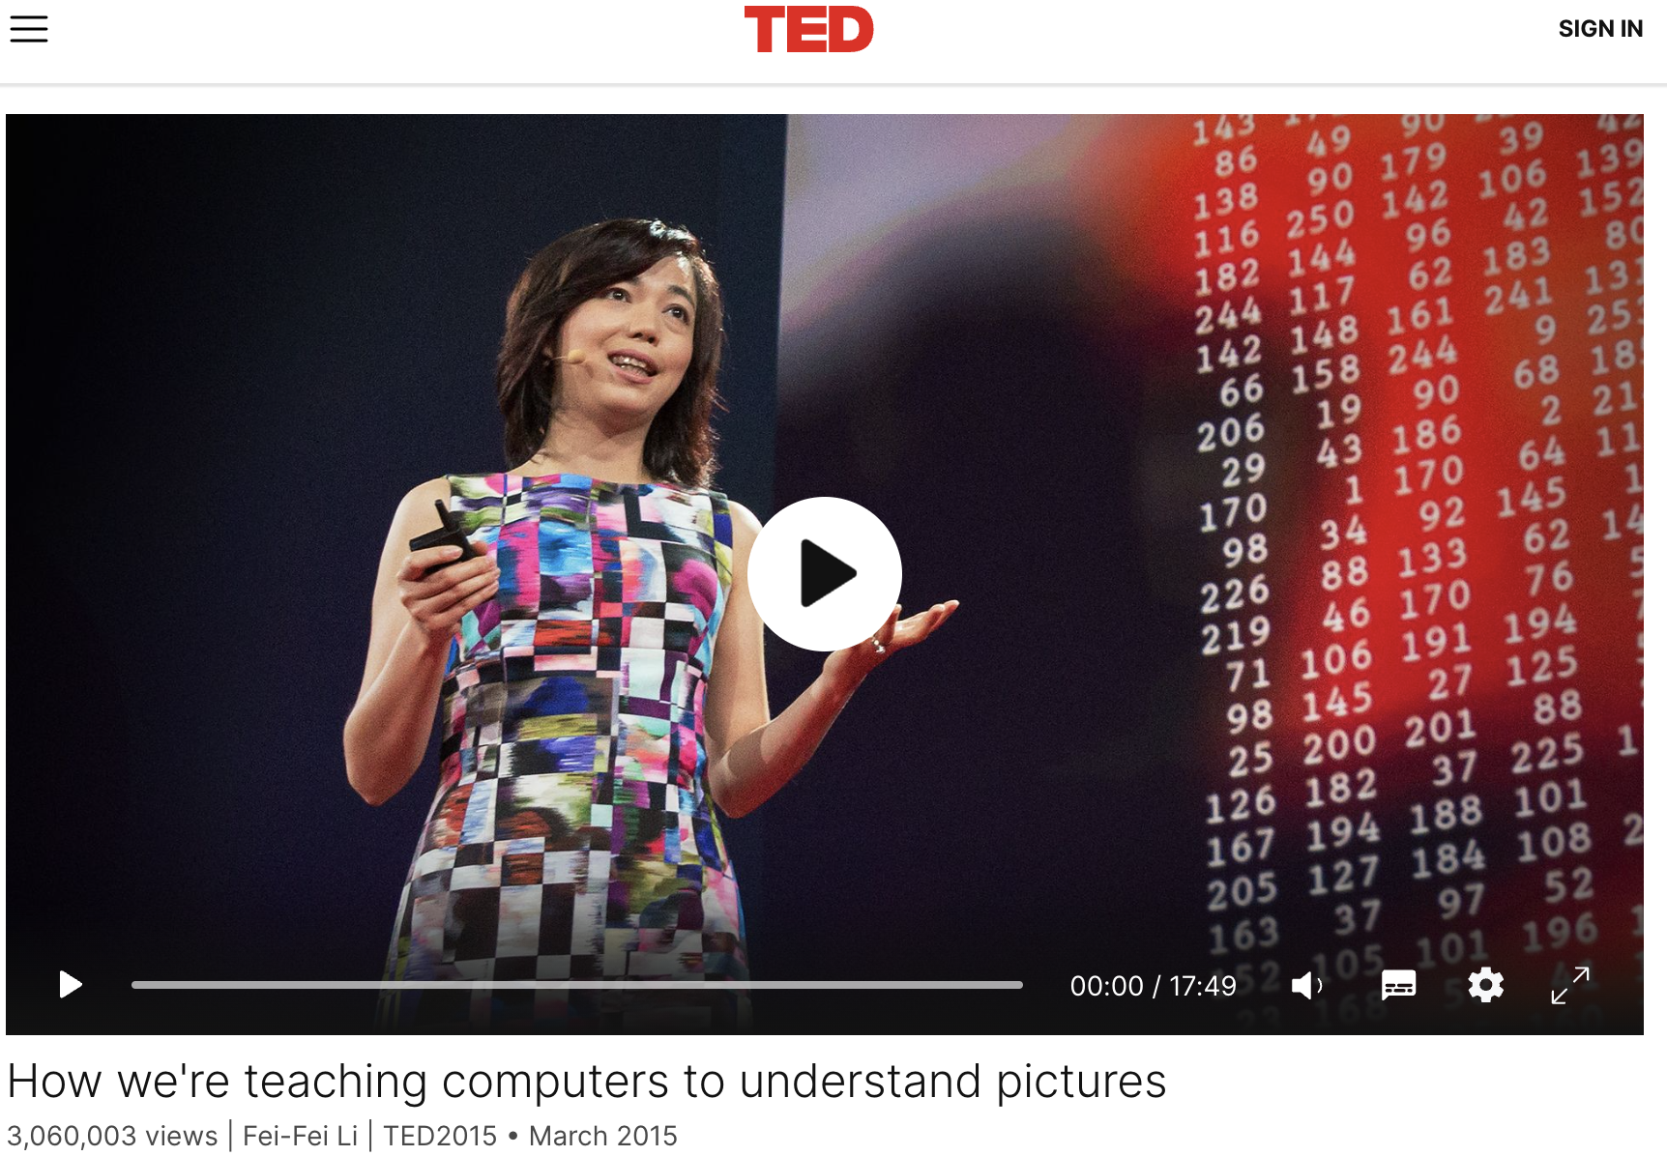
Lecture 2
ImageNet Large Scale Visual Recognition Challenge

Slide 2
Why Imagenet was so important
Imagenet is popularly used to refer to three different things:
A dataset of a thousand categories and a million images
A network (AlexNet or others) trained on that dataset
A competition – the large scale visual recognition challenge

Slide 3
MNIST (1998)
Classes/Images: 10 / 70,000
Notes: Popular for simple machine learning tasks, foundational for testing neural networks and classifiers.
CIFAR-10 / CIFAR-100 (2004)
Classes/Images: 10 (CIFAR-10), 100 (CIFAR-100) / 60,000 each
Notes: Challenging small-scale datasets; popular for benchmarking early classification models.
COIL-100 (1996)
Classes/Images: 100 / 7,200
Notes: Pioneering multi-view dataset, useful for object recognition.
Caltech-101 (2003)
Classes/Images: 101 / ~9,000
Notes: Frequently used for real-world object classification tasks.
Caltech-256 (2007)
Classes/Images: 256 / 30,607
Notes: Larger and more diverse, providing a greater challenge for classification models.
PASCAL VOC (2005)
Classes/Images: 20+ (varies by year) / Varies per challenge
Notes: Standard for evaluating object detection, segmentation, and classification.

Slide 4
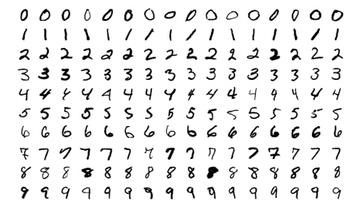
MNIST (1998)
Classes/Images: 10 / 70,000
Notes: Popular for simple machine learning tasks, foundational for testing neural networks and classifiers.
CIFAR-10 / CIFAR-100 (2004)
Classes/Images: 10 (CIFAR-10), 100 (CIFAR-100) / 60,000 each
Notes: Challenging small-scale datasets; popular for benchmarking early classification models.
COIL-100 (1996)
Classes/Images: 100 / 7,200
Notes: Pioneering multi-view dataset, useful for object recognition.
Caltech-101 (2003)
Classes/Images: 101 / ~9,000
Notes: Frequently used for real-world object classification tasks.
Caltech-256 (2007)
Classes/Images: 256 / 30,607
Notes: Larger and more diverse, providing a greater challenge for classification models.
PASCAL VOC (2005)
Classes/Images: 20+ (varies by year) / Varies per challenge
Notes: Standard for evaluating object detection, segmentation, and classification.

Slide 5
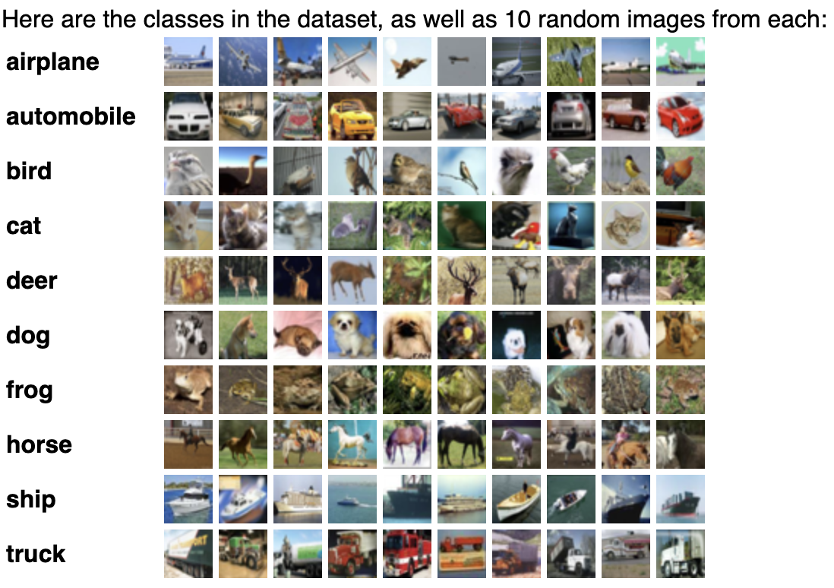
MNIST (1998)
Classes/Images: 10 / 70,000
Notes: Popular for simple machine learning tasks, foundational for testing neural networks and classifiers.
CIFAR-10 / CIFAR-100 (2004). 32x32 pixels
Classes/Images: 10 (CIFAR-10), 100 (CIFAR-100) / 60,000 each
Notes: Challenging small-scale datasets; popular for benchmarking early classification models.
COIL-100 (1996)
Classes/Images: 100 / 7,200
Notes: Pioneering multi-view dataset, useful for object recognition.
Caltech-101 (2003)
Classes/Images: 101 / ~9,000
Notes: Frequently used for real-world object classification tasks.
Caltech-256 (2007)
Classes/Images: 256 / 30,607
Notes: Larger and more diverse, providing a greater challenge for classification models.
PASCAL VOC (2005)
Classes/Images: 20+ (varies by year) / Varies per challenge
Notes: Standard for evaluating object detection, segmentation, and classification.

Slide 6
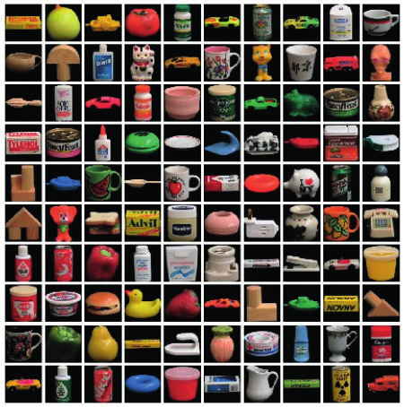
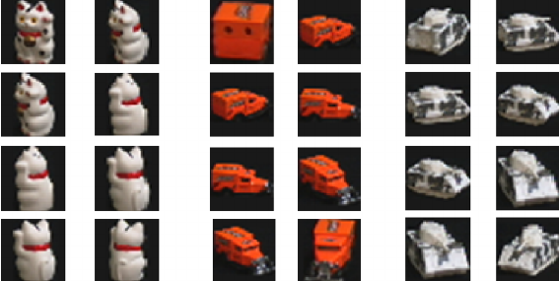
MNIST (1998)
Classes/Images: 10 / 70,000
Notes: Popular for simple machine learning tasks, foundational for testing neural networks and classifiers.
CIFAR-10 / CIFAR-100 (2004)
Classes/Images: 10 (CIFAR-10), 100 (CIFAR-100) / 60,000 each
Notes: Challenging small-scale datasets; popular for benchmarking early classification models.
COIL-100 (1996)
Classes/Images: 100 / 7,200
Notes: Pioneering multi-view dataset, useful for object recognition.
Caltech-101 (2003)
Classes/Images: 101 / ~9,000
Notes: Frequently used for real-world object classification tasks.
Caltech-256 (2007)
Classes/Images: 256 / 30,607
Notes: Larger and more diverse, providing a greater challenge for classification models.
PASCAL VOC (2005)
Classes/Images: 20+ (varies by year) / Varies per challenge
Notes: Standard for evaluating object detection, segmentation, and classification.

Slide 7
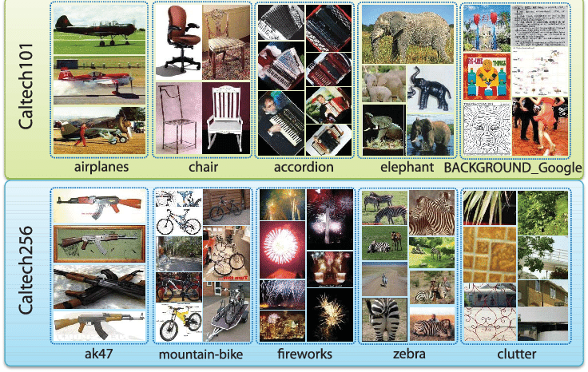
MNIST (1998)
Classes/Images: 10 / 70,000
Notes: Popular for simple machine learning tasks, foundational for testing neural networks and classifiers.
CIFAR-10 / CIFAR-100 (2004)
Classes/Images: 10 (CIFAR-10), 100 (CIFAR-100) / 60,000 each
Notes: Challenging small-scale datasets; popular for benchmarking early classification models.
COIL-100 (1996)
Classes/Images: 100 / 7,200
Notes: Pioneering multi-view dataset, useful for object recognition.
Caltech-101 (2003)
Classes/Images: 101 / ~9,000
Notes: Frequently used for real-world object classification tasks.
Caltech-256 (2007)
Classes/Images: 256 / 30,607
Notes: Larger and more diverse, providing a greater challenge for classification models.
PASCAL VOC (2005)
Classes/Images: 20+ (varies by year) / Varies per challenge
Notes: Standard for evaluating object detection, segmentation, and classification.

Slide 8
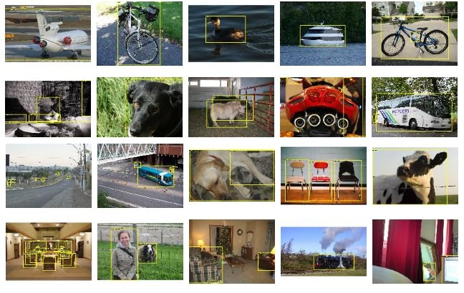
MNIST (1998)
Classes/Images: 10 / 70,000
Notes: Popular for simple machine learning tasks, foundational for testing neural networks and classifiers.
CIFAR-10 / CIFAR-100 (2004)
Classes/Images: 10 (CIFAR-10), 100 (CIFAR-100) / 60,000 each
Notes: Challenging small-scale datasets; popular for benchmarking early classification models.
COIL-100 (1996)
Classes/Images: 100 / 7,200
Notes: Pioneering multi-view dataset, useful for object recognition.
Caltech-101 (2003)
Classes/Images: 101 / ~9,000
Notes: Frequently used for real-world object classification tasks.
Caltech-256 (2007)
Classes/Images: 256 / 30,607
Notes: Larger and more diverse, providing a greater challenge for classification models.
PASCAL VOC (2005)
Classes/Images: 20+ (varies by year) / Varies per challenge
Notes: Standard for evaluating object detection, segmentation, and classification.

Slide 9
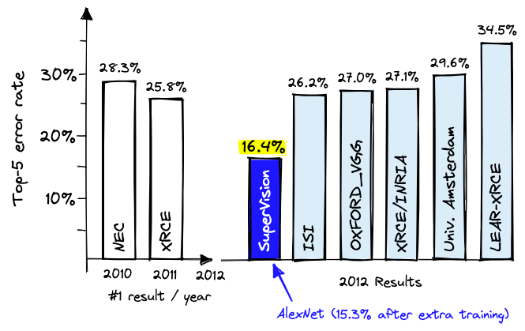
Imagenet vs. AlexNet

Slide 10
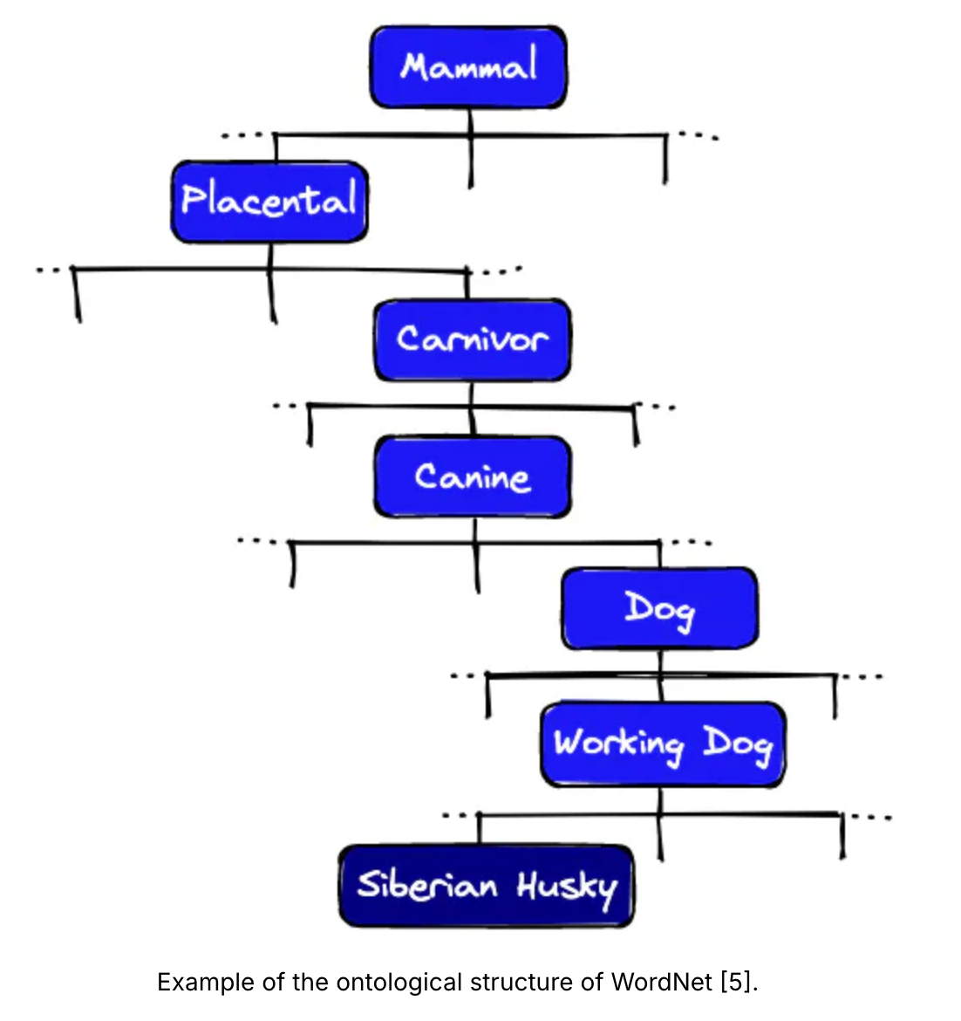

Slide 11
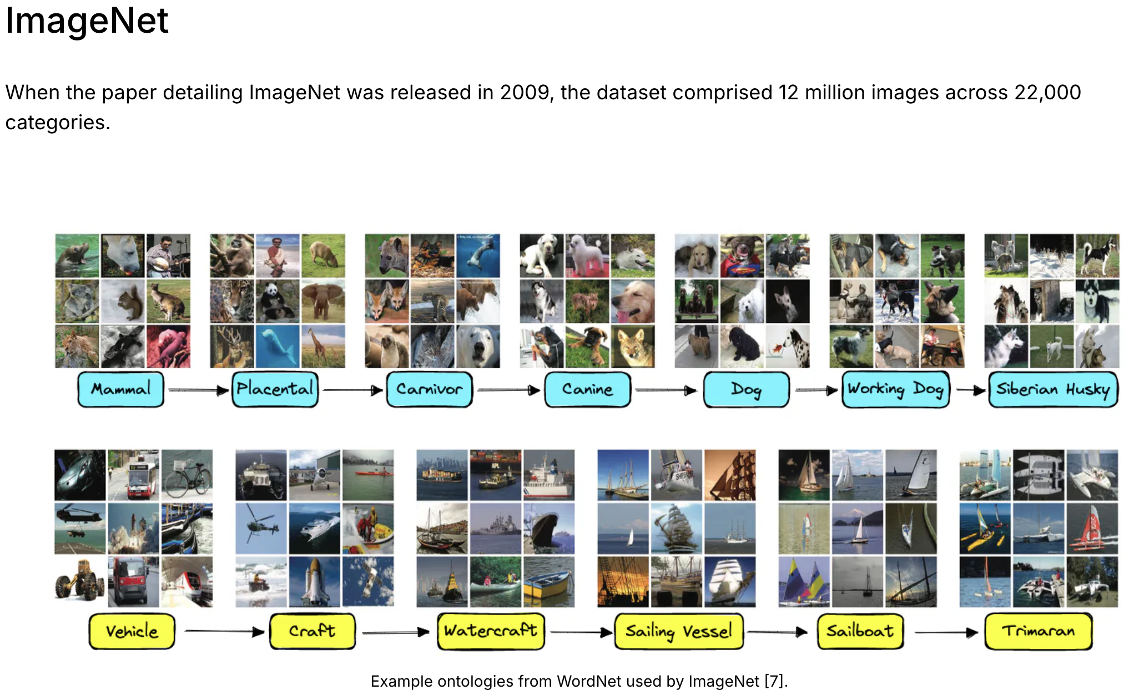

Slide 12
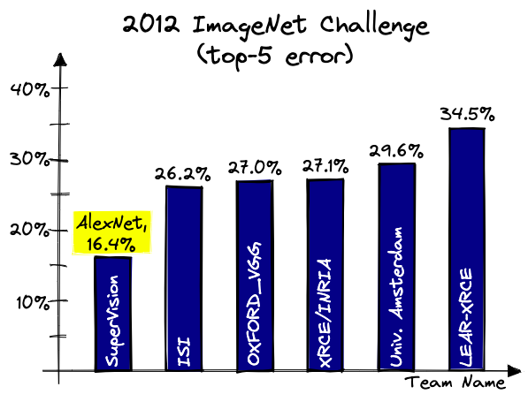

Slide 13
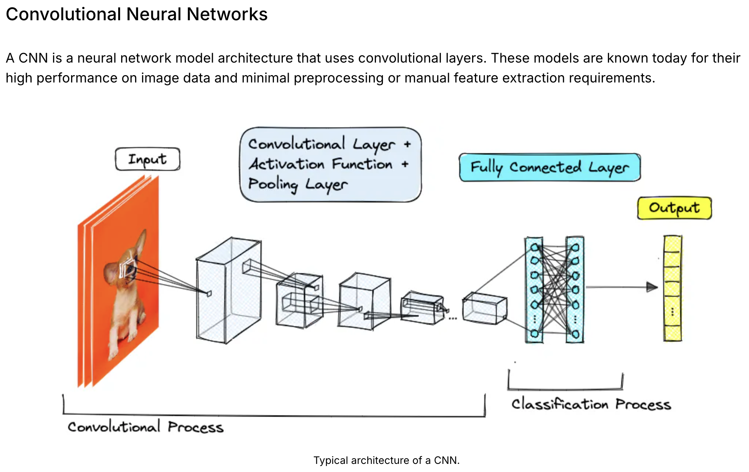

Slide 14
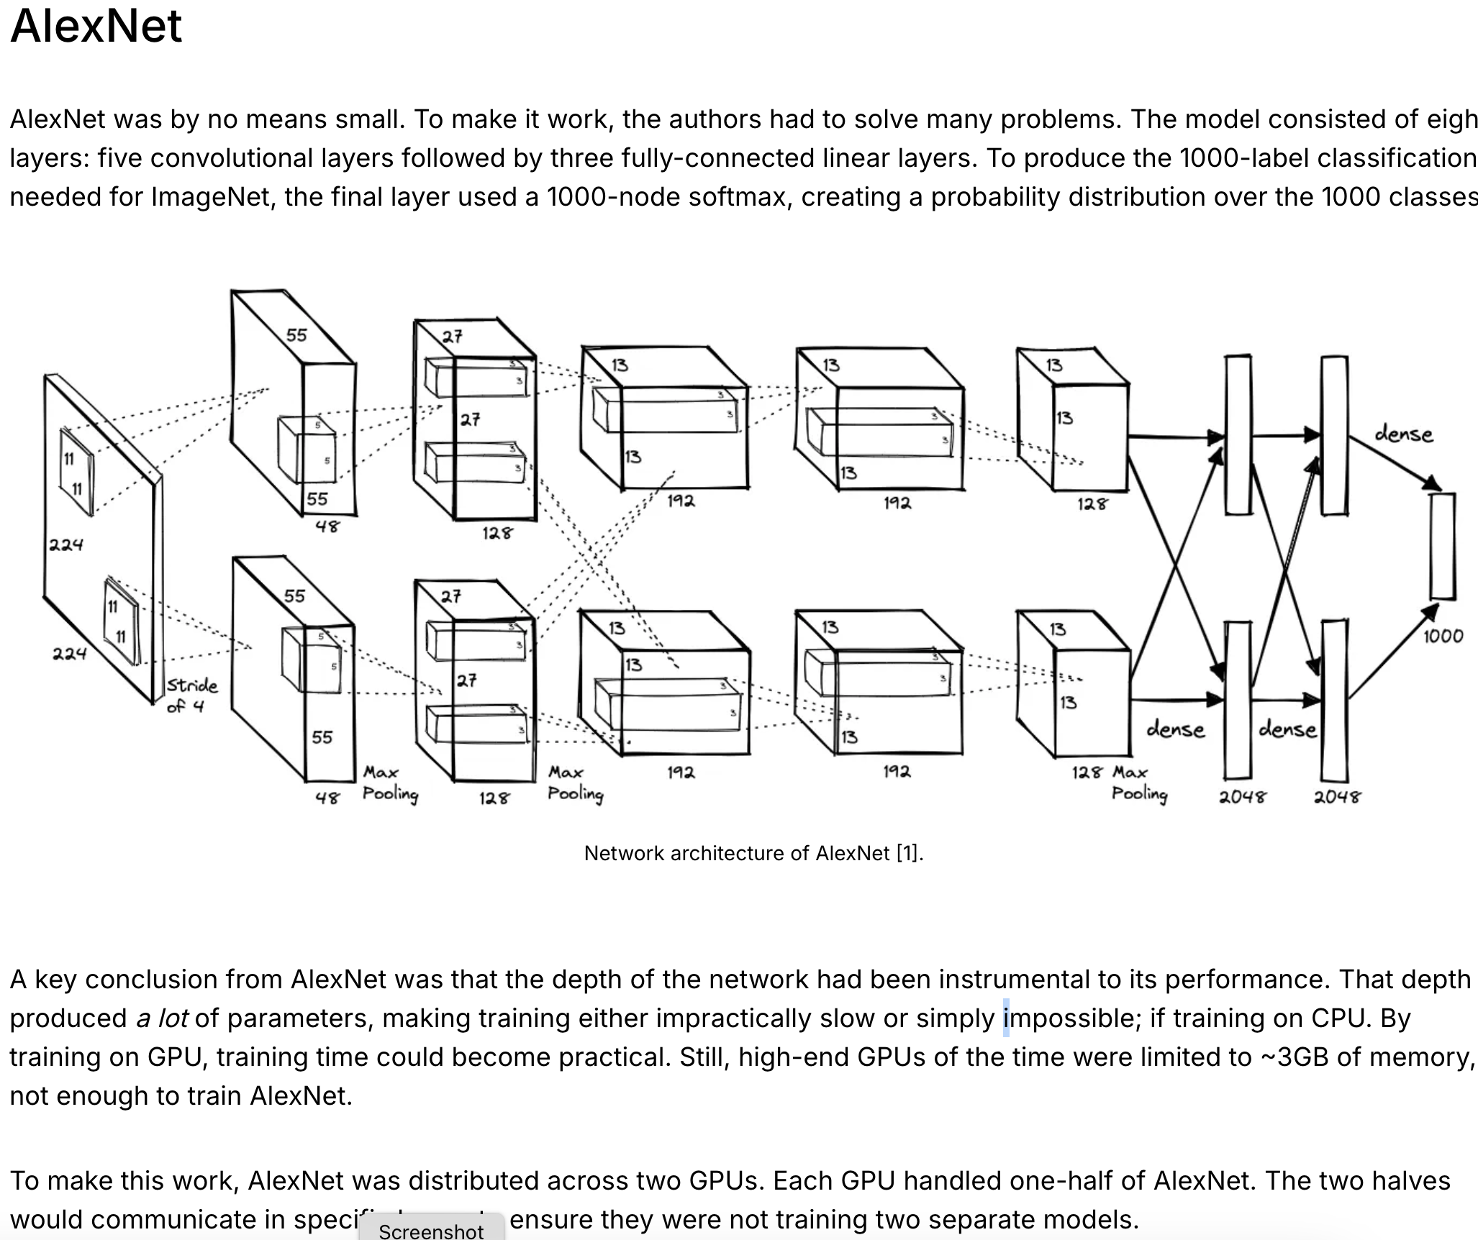

Slide 15
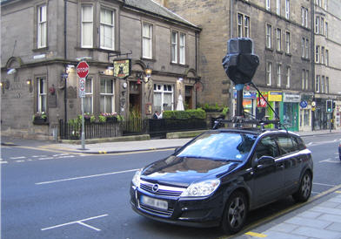
Large Scale Recognition
Millions to billions of images
Hundreds of thousands of possible labels
Recognition for indexing and retrieval
Complement current Pascal VOC competitions
LSVRC 2010
LSVRC 2011
Localization
Car
Car
Car
Categorization

Slide 16
Source for categories and training data
ImageNet
14,192,122 million images, 21841 thousand categories
Image found via web searches for WordNet noun synsets
Hand verified using Mechanical Turk
Bounding boxes for query object labeled
New data for validation and testing each year
WordNet
Source of the labels
Semantic hierarchy
Contains large fraction of English nouns
Also used to collect other datasets like tiny images (Torralba et al)
Note that categorization is not the end/only goal, so idiosyncrasies of WordNet may be less critical

Slide 17
ILSVRC 2011 Data
Training data
1,229,413 images in 1000 synsets
Min = 384 , median = 1300, max = 1300 (per synset)
315,525 images have bounding box annotations
Min = 100 / synset
345,685 bounding box annotations
Validation data
50 images / synset
55,388 bounding box annotations
Test data
100 images / synset
110,627 bounding box annotations

Slide 18

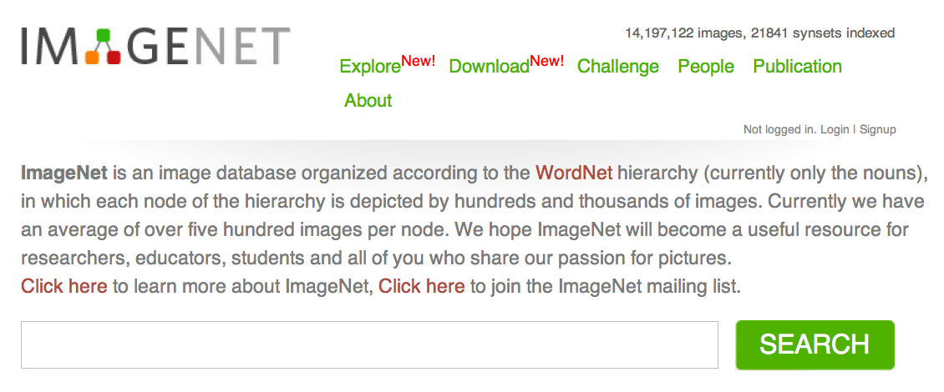
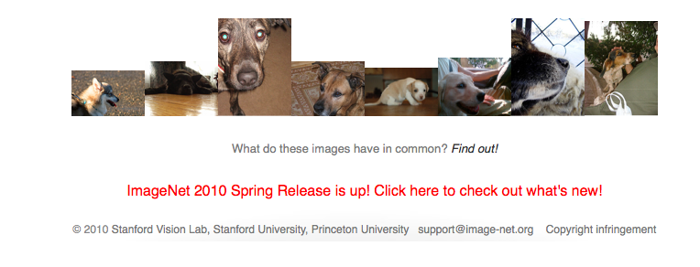

http://www.image-net.org
Jia Deng
(lead student)

Slide 19
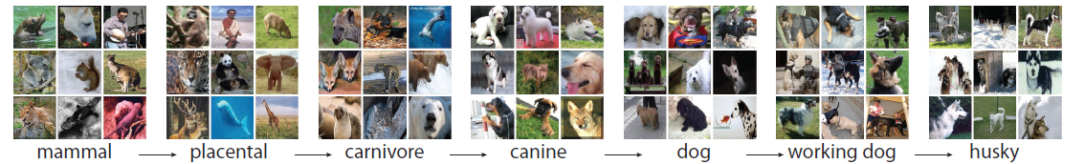
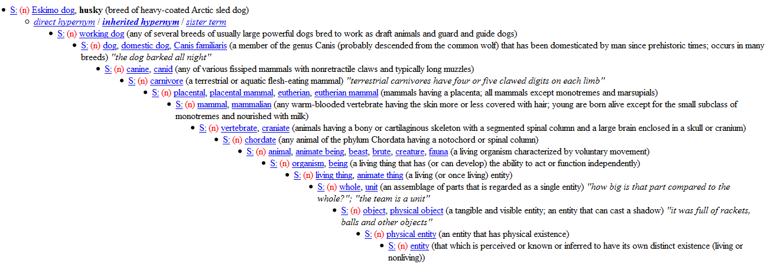
is a knowledge ontology
Taxonomy
Partonomy
The “social network” of visual concepts
Hidden knowledge and structure among visual concepts
Prior knowledge
Context

Slide 20
is a knowledge ontology
Taxonomy
Partonomy
The “social network” of visual concepts
Hidden knowledge and structure among visual concepts
Prior knowledge
Context

Slide 21
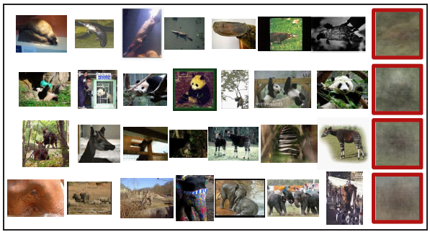

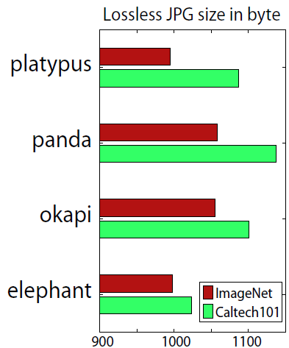
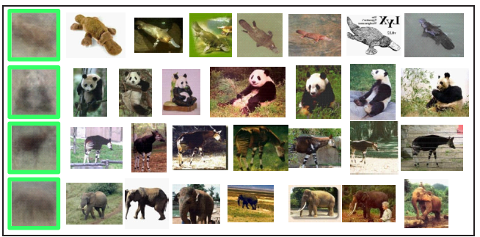
diversity
Diversity
Caltech101

Slide 22
Classification Challenge
Given an image predict categories of objects that may be present in the image
1000 “leaf” categories from ImageNet
Two evaluation criteria based on cost averaged over test images
Flat cost – pay 0 for correct category, 1 otherwise
Hierarchical cost – pay 0 for correct category, height of least common ancestor in WordNet for any other category (divide by max height for normalization)
Allow a shortlist of up to 5 predictions
Use the lowest cost prediction each test image
Allows for incomplete labeling of all categories in an image

Slide 23
Participation
96 registrations
15 submissions
Top Entries
Xerox Research Centre Europe
Univ. Amsterdam & Univ. Trento
ISI Lab Univ. Tokyo
NII Japan

Slide 24
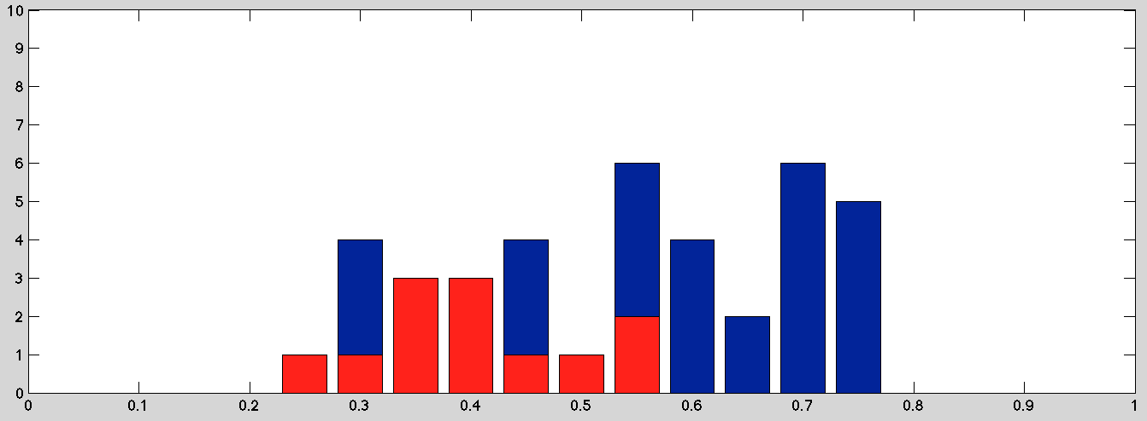
Classification Results Flat Cost, 5 Predictions per Image
2011
0.26
2010
0.28
Baseline
0.80
# Entries
Flat Cost
Probably evidence of some self selection in submissions.

Slide 25
Best Classification Results 5 Predictions / Image

Slide 26
Classification Winners
XRCE ( 0.26 )
Univ. Amsterdam & Univ. Trento ( 0.31 )
ISI Lab Tokyo University ( 0.34 )

Slide 27
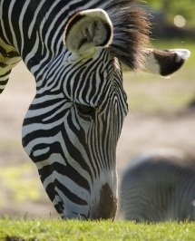
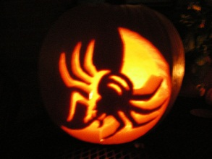
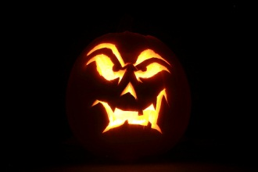

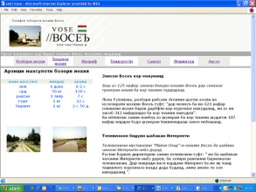
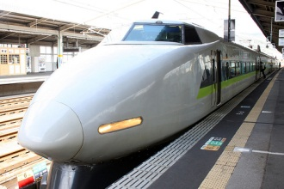
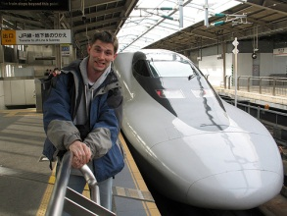
Easiest synsets
web site, website, internet site, site | 0.067
jack-o'-lantern | 0.117
odometer, hodometer, | 0.127
manhole cover | 0.127
bullet train, bullet | 0.147
electric locomotive | 0.150
zebra | 0.163
daisy | 0.170
pickelhaube | 0.170
freight car | 0.180
nematode, nematode worm, roundworm | 0.180
* Numbers indicate the mean flat cost from the top 5 predictions from all submissions

Slide 28
Toughest Synsets
water jug | 0.940
cassette player | 0.940
weasel | 0.943
sunscreen, sunblock, sun blocker | 0.943
plunger, plumber's helper | 0.947
syringe | 0.950
wooden spoon | 0.953
mallet | 0.957
spatula | 0.963
paintbrush | 0.967
power drill | 0.973
* Numbers indicate the mean flat cost from the top 5 predictions from all submissions

Slide 29
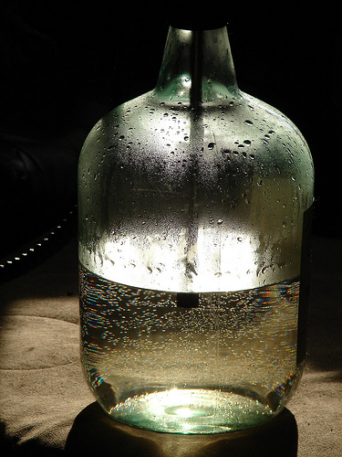
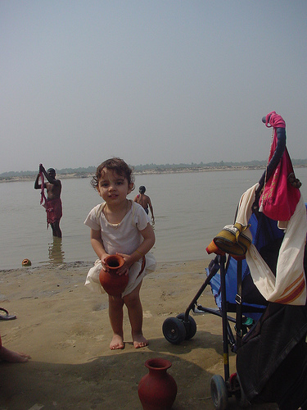
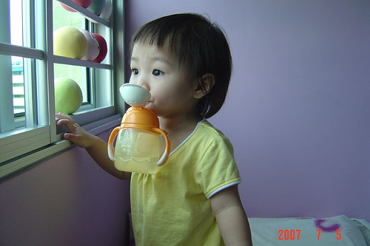
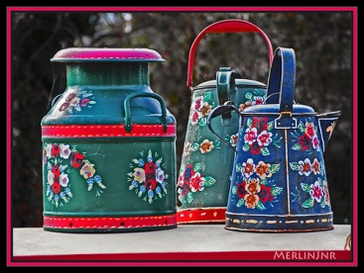
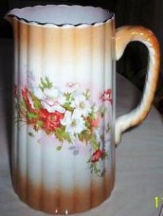
Water-jugs are hard!

Slide 30
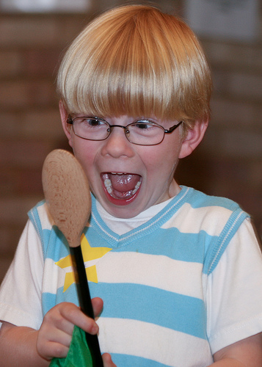
But wooden spoons?

Slide 31
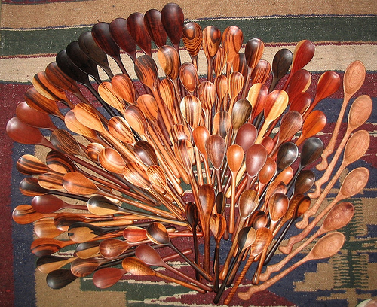
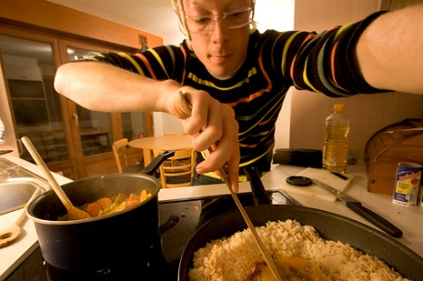
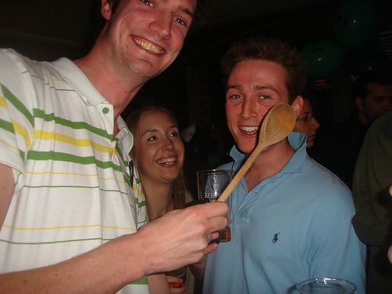
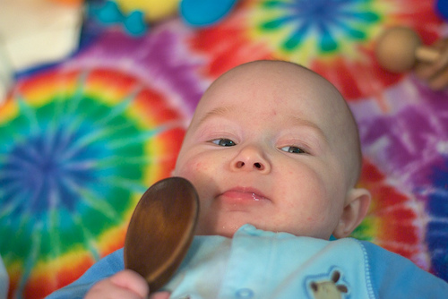
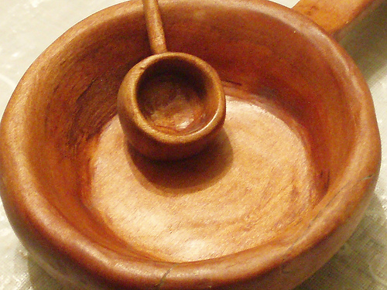

Slide 32
Easiest Subtrees
Synset | # of leaves | Average flat cost
furniture, piece of furniture | 32 | 0.4563
vehicle | 65 | 0.4728
bird | 64 | 0.5092
food | 21 | 0.5362
vertebrate, craniate | 256 | 0.5804

Slide 33
Hardest Subtrees
Synset | # of leaves | Average flat cost
implement | 55 | 0.7285
tool | 27 | 0.7126
vessel | 24 | 0.6875
reptile | 36 | 0.6650
dog | 31 | 0.6277

Slide 34
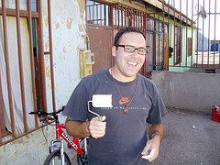
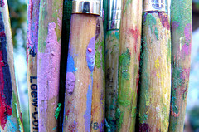
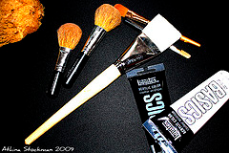
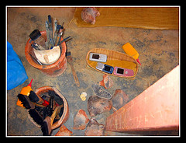
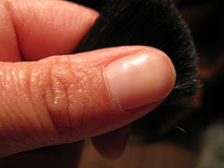
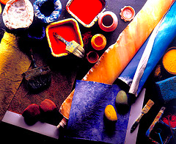
Most difficult paintbrushes!

Slide 35




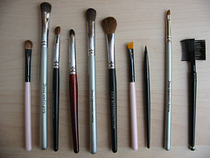

Easiest paintbrushes

Slide 36
Localization Challenge

Slide 37
Entries
Two Brave Submissions
Team | Flat cost | Hierarchical cost
University of Amsterdam & University of Trento | 0.425 | 0.285
ISI lab., the Univ. of Tokyo | 0.565 | 0.41

Slide 38
Precision
Best | Worst
jack-o'-lantern | paintbrush
web site, website, internet site, site | muzzle
monarch, monarch butterfly, | power drill
rock beauty [tricolored fish] | water jug
golf ball | mallet
daisy | spatula
airliner | gravel, crushed rock

Slide 39
Recall
Best | Worst
jack-o'-lantern | paintbrush
web site, website, internet site, site | muzzle
monarch, monarch butterfly, | power drill
rock beauty [tricolored fish] | water jug
golf ball | mallet
manhole cover | spatula
airliner | gravel, crushed rock

Slide 40
Imagenet navigator
https://navigu.net/#imagenet

Slide 41
1. Technical Methods Used in the Paper (SIFT, NBNN, NN-voting, Bag-of-Features)
SIFT descriptors, NBNN, NN-voting, bag-of-words features, and why certain classifiers performed better. One version: Could you explain SIFT descriptors and the NBNN method used in Section 4.1, and why it performed better than simple NN voting?

Slide 42
2. Hierarchy and WordNet Structure
Questions about why WordNet was used, whether semantic hierarchy helps, issues with mismatches (e.g., dolphins as mammals), and class imbalance between fine-grained and broad categories. question: How does the hierarchical WordNet structure help in classification, and what problems arise when semantic similarity doesn’t match visual similarity (like dolphins vs. fish)?

Slide 43
3. Annotation Process and Mechanical Turk
Students asked about how labeling worked, how workers handled ambiguous/multi-object images, bias and reliability of AMT, and whether we still need humans or could automate. question: How did ImageNet use Amazon Mechanical Turk for labeling, and can modern AI methods replace or reduce the need for human annotation today?

Slide 44
4. Dataset Scale, Diversity, and Bias
Questions about dataset biases (Western-centric, stock-photo skew, Instagram-like bias), ensuring diversity, duplicate removal, private data issues, and rare categories. question: Since ImageNet was built from internet photos and crowd workers, what kinds of hidden biases does it contain, and how can those biases affect model performance?

Slide 45
6. Practical Issues of Construction (Storage, Efficiency, Quality Control)
image storage, file sizes, confidence thresholds, criteria for image acceptance, and how large-scale data was maintained with high accuracy. Prototype question: With millions of high-resolution images, how did ImageNet manage efficiency, storage, and quality control while still maintaining high accuracy?

Slide 46
“Is using lossless JPG file size of average images a robust way to measure visual diversity in ImageNet synsets? What alternative ways can we use currently to better capture diversity like viewpoint or lighting?”
“It is mentioned in the paper that they collected 3.2 million data. Where did they store such big data? silly question, but i just wanted to know.”
“What does SSD pixel distance mean in context of image classification?” SSD (sum of squared differences) isn’t a big theme of the paper
“When cleaning and labeling the images, did they pay attention to things like lighting differences, eg: if a picture was too dark, too bright, or taken at night or did the diversity of images naturally take care of that?”
“Since these images are taken from the internet, how do we ensure it’s not someone’s private information? Who owns these images?”

Slide 47
“Why not having segmentation annotations was considered a limitation of ImageNet?” → Shows awareness that classification alone is limited, and anticipates the importance of datasets like COCO and segmentation benchmarks.

Slide 48
“ImageNet mostly relied on the IS-A relation in WordNet. But WordNet also has relations like part-of or similar-to. Why didn’t they explore those, and would including them make the dataset more powerful for tasks like part recognition or scene understanding?”

Slide 49
“In recognition experiments mixing ImageNet with Caltech-style sets, how do we separate true method gains from domain shift (photographer bias, background, resolution)?”

Slide 50
“With tens of thousands of synsets, how should categories be prioritized for completion? What about abstract/ambiguous synsets that may never reach the target image count?” → A deep dataset design/coverage question — essentially about balancing breadth vs. depth, still an open methodological issue.

